Slide 1
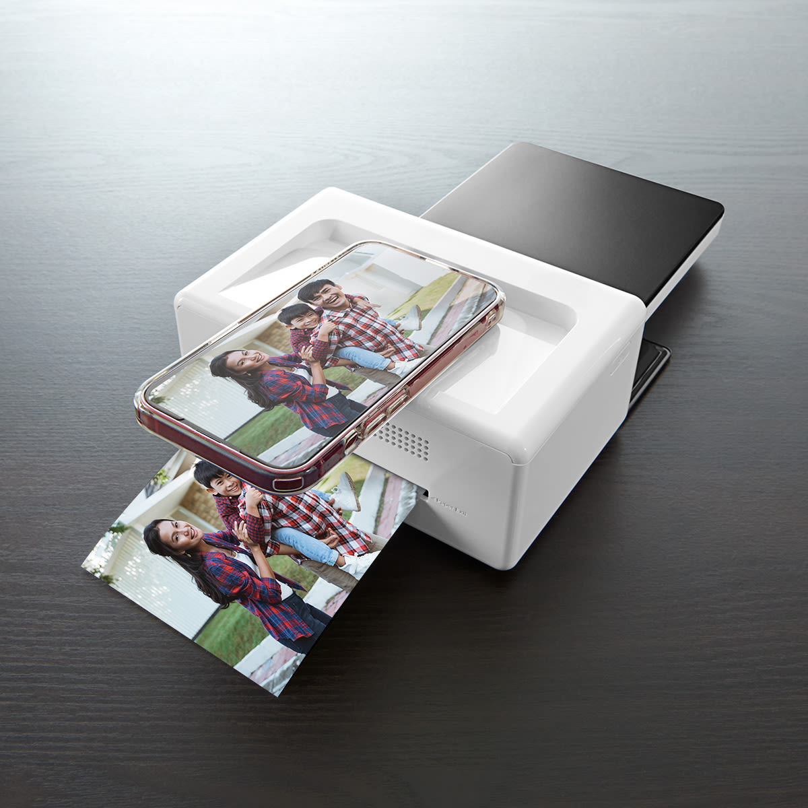
Smart Printing Solution
Revolutionizing Document Printing with Secure, On-Demand Solutions

Slide 2

The Company Purpose
"To revolutionize document printing by providing secure, on-demand, and eco-friendly solutions that empower individuals and businesses."

Slide 3

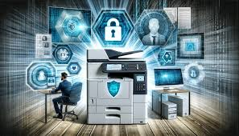

The Element of Problem
Long queues at Printing Shops
Lack of secure and ondemand printing solution
High costs for small scale printing need

Slide 4

The Product
Fully Automated and self printing
User can upload , secure and print document seamlessly
Affordable , secure , available 24/7

Slide 5

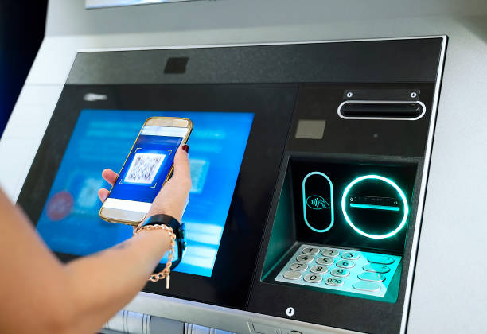
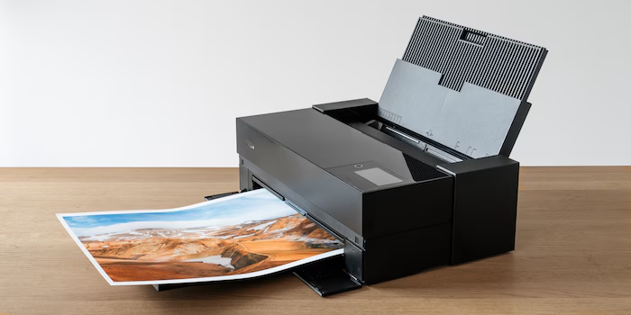
User Uploads a document via thrir device with security key and machine generted unique code
How It works : Simple and Secure
User enters code and password on vending machine and select printing options
Pays via QR code and recives printed document

Slide 6
Target Audience:
Students: Affordable, quick printing for assignments and exams
Professionals: Secure, on-demand printing for reports and presentations.
Small Businesses: Cost-effective solutions for invoices and marketing materials.
Printing for All: Students, Professionals, and Small Businesses

Slide 7
Market Potential: A Growing Need for Smart Document Solutions
Market Size and Growth:
Global Printing Market: $760 billion (2022), growing at 4.5% CAGR.
Self-Service Printing Segment: $12.5 billion by 2025.
India Printing Industry: Growing at 6% annually.

Slide 8
Business Model
1
2
3
Pay-per-use model
Subscription plans for frequent users
Partnerships with educational institutions and offices.

Slide 9
Functional prototype completed.
Key features implemented: Document upload, secure storage, printing options, payment integration.
Positive feedback from early users.
What We’have Achieved so far

Slide 10
Thank you!
Be part of the future of printing.
NIhar Joshi : 7058250805

